Slide 1


SHRI SANT GAJANAN MAHARAJ COLLEGE OF ENGINEERING, SHEGAON
Google Developer Student Clubs
UN Sustainable Development Goals (4): Quality Education
PROJECT TITLE :
STUDENT EDUCATION PLATFORM (SEP)
GOOGLE SOLUTION CHALLENGE 23-24
PROJECT GROUP MEMBERS:
Saurabh Wankhede (GDSC SSGMCE Lead)
Vaishnavi Dabhade (GDSC SSGMCE Core Team Member)
, Prajwal Gawande (GDSC SSGMCE Member)
Sanket Gode (GDSC SSGMCE Member)

Slide 2


PROBLEM DEFINITION :
This project creates a modern educational platform for seamless digital learning. it aims to enhance education quality, learning outcomes, collaboration, and security. With interactive modules, assessments, and communication tools, the platform offers personalized learning experiences. This project envisions revolutionizing education through personalized experiences and user-friendly interfaces.

Slide 3

PROJECT OBJECTIVES
Seamless Learning: Create an interactive, progress-tracked platform for smooth learning.
Quality Enhancement: Provide high-quality content and diverse learning methods.
Collaborative Environment: Encourage teacher-student and peer interaction.
Security and Compliance: Ensure data security through encryption and authentication.
Insightful Analytics: Empower educators with data-driven insights for personalized teaching.
Personalized Learning: Customize learning paths based on individual strengths and preferences.
Technical Innovation: Leverage cloud and microservices for scalability and efficiency.
Transformational Impact: Redefine education in alignment with evolving technology.

Slide 4
LITERATURE SURVEY
Page Name &
Publication
Design of Digital Educational Resource Platforms in University International Symposium on Computer Science and Computational Technology
Findings
1) Flow of Construction of Digital Educational Resource Platform
2) Architecture of the Digital Educational Resource
Methodology
1. Survey Research Literature: Review existing studies
and identify themes and gaps.
2. Study Case Examples: Analyze successful and
unsuccessful case studies for design insights.
Shortcoming
As it's about resources sharing only there is lot more research opportunities as technology is growing.
Expected Research
research main focus to
analyse the architecture of system which are similar to project idea.

Slide 5
LITERATURE SURVEY
Page Name &
Publication
Cloud E-learning and Benchmarking Platform for the Parallel and Distributed Computing Course IEEE 3-5 April 2014
Research paper on E-Learning Application Design Features ICICES 2016
Findings
System Functionality, Resource Provision Strategy
Cloud Services, Cloud Application Design, Cloud System Architecture Model, Application Implementation Model Flow, AI in E- learning systems
Methodology
Cloud Distribute and Parallel Algorithm,
Linear Algebra Algorithm
Cloud Application Desiging Methodology, Virtual Learning Environments (VLEs)
And
and Personal Learning Environments (PLEs) Methodology
Shortcoming
Lack of details on
specific challenges or limitations in the implementation of the cloud e-learning and
benchmarking
platform for the Parallel and
Distributed Computing Course.
Expected Research
Investigating the effectiveness of the
platform in improving
students' understanding and performance in
Parallel and Distributed Computing.

Slide 6
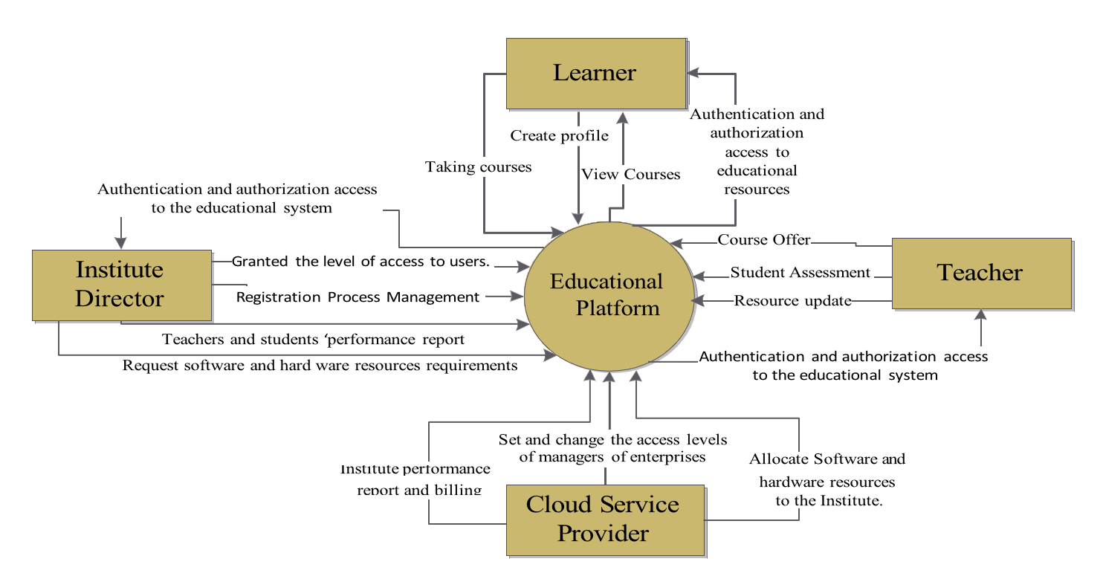
Data Flow Diagram:

Slide 7
TECHNOLOGY STACK
Deployment & Scallability
Front-end
Back-end
Privacy & Security
Web Interface: HTML , CSS,
Javascript, Typescript
Server-side: Python, Gemeni API
Server-Side Framework:Django-rest- framework-jwt
Cloud Platform: Google Cloud
Framework: ReactJs
Framework : Django, TensorFlow
Authentication & Authorization
Cloud Hosting
State-Management Redux Toolkit
Database: Firebase, Mongo DB
HTTPS & SSL/TLS
Web Server

Slide 8
FLOWCHART
Planning Phase
identify
Require-ment
Choose
Technology Stack
Design Database Schema
Development Phase
Create User Authentica-tion
Develop
Frontend UI
ImplementUser Manage-ment
Design Course manage-ment
Implement content Delivery
Implement Progress Tracking
Develop Collabora- tion Tools
Build Assessment System
Quality Assurance
Test & Debug System
Deployment Phase
Deploy to Production
Identify & Fix Issues
Re-deploy
& Monitor
Consider Refactoring
Creating Reporting Mechanism
Monitoring & Maintenance

Slide 9

REQUIREMENTS
User Registration & Authentication User Profile Management
User Specific Features Video conferencing
Maintaining accounts for various roles User Interaction & Interface
Real-Time Data Updates Data Privacy
Non-Functional Requirements:
Performance Scalability
User Experience Data Security

Slide 10




PROJECT PLAN
Architecture: Decide complete Flow of application and data handling
Development: Starting With Selecting Appropriate
Technology Stack
Initiation: Start the “Project
Educational Platform.“
Research & Planning: Study existing systems.
UI & Security: Design a secure, user-friendly interface.
Maintenance:
Adding More
Features as per requirements.
Testing: Test the Working of Application In
Deployed Version.
Deployment: After Successfully Testing Deploy the
feature on Development Environment
Testing: Test Every
Feature After Completing
Development: Start With Phase wise Design of System Based On Features

Slide 11

THANK YOU

